Slide 1
K Nearest Neighbor

Slide 2
Introduction
K Nearest Neighbor is a simple algorithm that stores all the available cases and classifies the new data or case based on a similarity measure.
KNN is a lazy learning, non-parametric algorithm
KNN is non-parametric since it doesn’t make any assumptions on the data being studied, i.e., the model is distributed from the data.
K-NN is a lazy learner because it doesn’t learn a discriminative function from the training data but “memorizes” the training dataset instead.
Distance Metrics-
Euclidean Distance
Cosine Similarity
Chebyshev Distance
Manhattan Distance

Slide 3

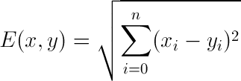
Features of KNN
Quick calculation time
Simple algorithm
Can be used for regression and classification
High accuracy algorithm
No assumptions about data

Slide 4
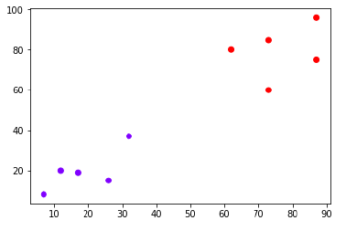
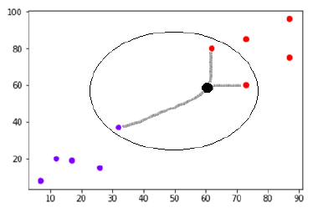
How KNN Works
Load the data
We need to choose the value of K i.e. the nearest data points. K can be any integer.
Iterate from 1 to Training Size of rows
Calculate the distance between test data & each row of the training set.
The metrics used are Euclidean distance/cosine similarity etc
Sort the values on ascending order based on the metric selected
Get the TOP K Rows from them
If it is classification, choose the MODE
If it is Regression, choose the mean from them

Slide 5
Hyper parameter Tuning
n_neighbors int, default=5 –
Number of neighbors to use by default for K neighbors queries.
weights{‘uniform’, ‘distance’} or callable, default=’uniform’
weight function used in prediction.
Possible values:
‘uniform’ : uniform weights. All points in each neighborhood are weighted equally.
‘distance’ : weight points by the inverse of their distance. in this case, closer neighbors of a query point will have a greater influence than neighbors which are further away.
leaf_size int, default=30
Leaf size passed to BallTree or KDTree. This can affect the speed of the construction and query, as well as the memory required to store the tree.
The optimal value depends on the nature of the problem.

Slide 6
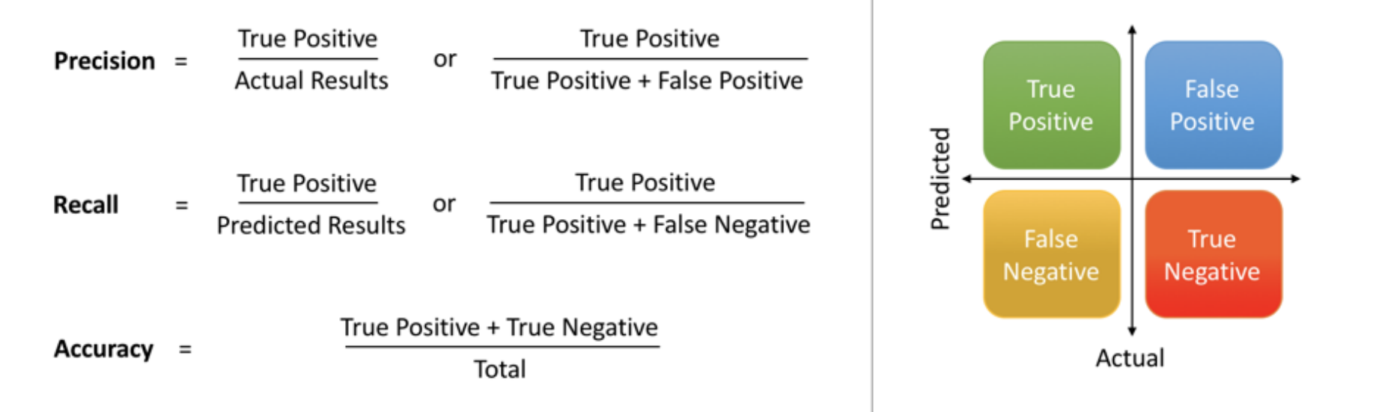
Model Evaluation Metrics
The various metrics used to evaluate
the results of the prediction are :
Accuracy
Precision
Recall
Area Under ROC Curve
MAPE/ MAD/ RMSE (For Regressors)

Slide 7
KNN –Cons
Depends on the quality of the data
With large data, the prediction stage might be slow
Sensitive to quality of data and irrelevant features
Require high memory – need to store all of the training data
Computationally expensive

